Slide 1
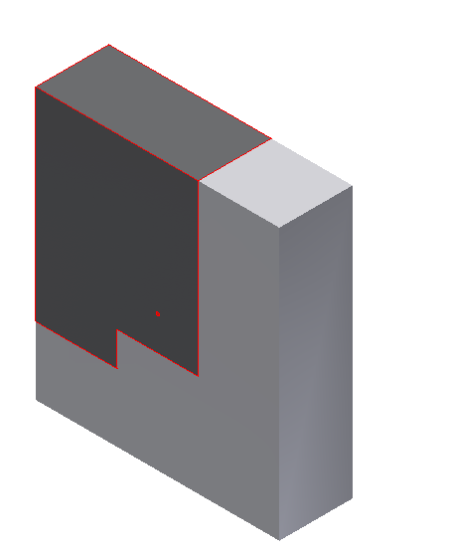
Signal Features
One Data Sample
of 54 signal features
2 kN Layer
Force Magnitude
750 N Layer
LScap
500 N Layer
RScap
Pelvis
Torso
0 N Layer
Force Location
LLowerLeg
RLowerLeg

